Slide 1
Hill Country Underground Water Conservation District
Year 2019
36.108 (c) 1: 5 of 11 Applicable Goals from 36.1071 (a)
Providing the Efficient Use of Groundwater
Controlling and Preventing Waste of Groundwater
Addressing Drought Conditions
Addressing Conservation and Precipitation Enhancement
Addressing the DFC

Slide 2
Hill Country Underground Water Conservation District
Providing the Efficient Use of Groundwater
Goals | Performance Standard/Objective | Objective | # Of WLM | # of Reg. or Permitted Wells Issued | Obtained | Achieved Yes/No
Goal A | Providing the most efficient use of groundwater
 | A.1 - Each year the District will assist the Gillespie County Commissioners Court in the evaluation of water availability studies |  |  |  |  | on-going
 | A.2 - Number of exempt wells registered by the District |  |  | 180 |  | on-going
 | A.3 - Number and type of applications made for permitted use of groundwater by the District
 | Commercial |  |  | 3 |  | on-going
 | Commercial/Irrigation |  |  | 2 |  | on-going
 | Irrigation |  |  | 12 |  | on-going

Slide 3
Hill Country Underground Water Conservation District
Controlling and Preventing Waste of Groundwater
Goals | Performance Standard/Objective | Objective | # Of WLM | # of Reg. or Permitted Wells Issued | Obtained | Achieved Yes/No
Goal B | Controlling and preventing waste of groundwater
 | B.1 - Summary of District activities during the year to disseminate educational information on eliminating and reducing the waste of groundwater focusing on water quality protection.
 | Information on District's website |  |  |  | yes | on-going
 | Conduct public presentations |  |  |  | 4 | on-going
 | Submit newspaper articles for publication |  |  |  | 2+ | on-going
 | Distribute brochures/literature |  |  |  | 75-100 | available at District office/on-going

Slide 4
Hill Country Underground Water Conservation District
Addressing Drought Conditions
Goals | Performance Standard/Objective | Objective | # Of WLM | # of Reg. or Permitted Wells Issued | Obtained | Achieved Yes/No
Goal F | Addressing Drought Conditions
 | F.1- Number of new trigger conditions identified and changes made to the drought management plan. The District routinely maintains a local drought index for Gillespie County based on multiple local hydrological drought sensitive parameters. See next side. |  |  |  |  | on-going
 | F.2 - Number reports at monthly board meeting on the need to implement the drought management plan. |  |  |  | * | on-going
 |  | *Discussed drought conditions at all board meetings in 2019.
 |  | Continue to monitor local aquifer and drought conditions.
 | F.3 - Information to the public on the District website on the status of the drought conditions and stage of drought.. |  |  |  |  | 6+/on-going
 |  | *Various articles & charts on District website
 | F.4 - Continue to monitor drought conditions through the TWDB Water Data for Texas Drought link |  |  |  | * | on-going
 |  | *Various articles & charts on District website

Slide 5
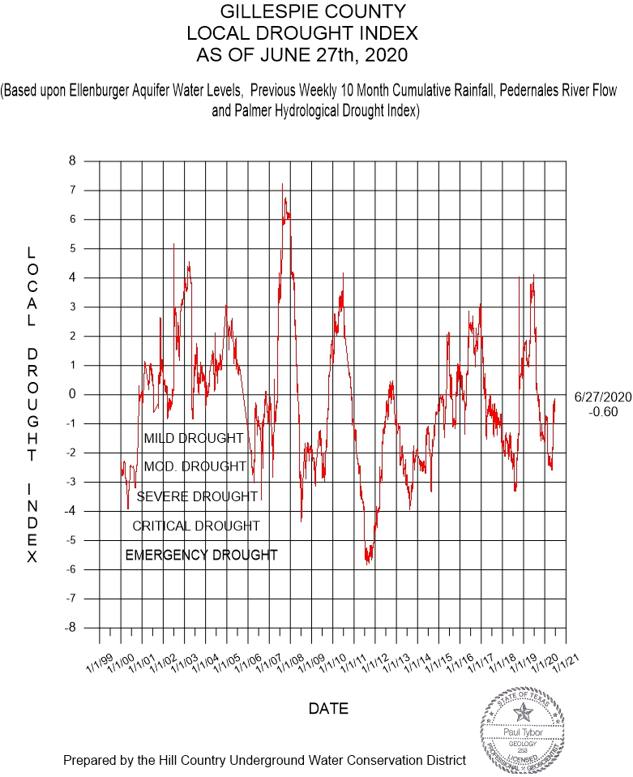

Slide 6
Hill Country Underground Water Conservation District
Addressing Conservation and Precipitation Enhancement
Goals | Performance Standard/Objective | Objective | # Of WLM | # of Reg. or Permitted Wells Issued | Obtained | Achieved Yes/No
Goal G | Addressing Conservation, Recharge Enhancement, Rainwater Harvesting, and Brush Control
 | G.1 - Summary of District's activity to promote conservation.
 | Information on District's web site |  |  |  | yes
 | Conservation brochures/literature to the public |  |  |  | 75-100 | available at District office/on-going
 | Conduct public conservation presentation |  |  |  | 4 | on-going
 | Other | Contributed $2,500 - Sponsorship to 4-H Water Ambassadors Program and $250 (GMA 7)
 | G.2 - Summary of District's activity regarding recharge enhancement. |  |  |  |  | links available on web site
 | G.3 - Summary of District's activity regarding rainwater harvesting. |  |  |  | 2-5 | literature available at District office and web site
 | G.4 - Summary of District's activity regarding brush control. |  |  |  |  | links available on web site
 | G.5 - Precipitation Enhancement - management goal is not applicable to the operations of the District. (cost prohibitive, results questionable) | not applicable to the operations of the District

Slide 7
Hill Country Underground Water Conservation District
Addressing the DFC
Goals | Performance Standard/Objective | Objective | # Of WLM | # of Reg. or Permitted Wells Issued | Obtained | Achieved Yes/No
Goal H | Addressing in a quantitative manner the DFC of the groundwater resources.
 | H.1 - How the DFCs are being met | Monitor water levels; below MAG and not issued permits that exceed MAGs
 | H.2 - Reporting of annual groundwater pumpage | Annual production reports will be sent out in January 2020 for year 2019

Slide 8
Hill Country Underground Water Conservation District
Year 2019
36.108 (c) 2: Effectiveness
Data Collection and Analysis
District has the following programs in place: three water level monitoring programs ( Ellenburger, Hensel & County Wide); well plugging program; geophysical logging program; downhole video program; water testing program for bacteria and chemical analysis; in-house database program; permit and registered wells; in-house laboratory to conduct water quality analyses (chemical and bacteria)
Mapping of data collected (i.e. water level maps, cross sections); water quality results helps identity areas in county where there might be high concentrations of some constituent-specific (i.e. nitrates)
Coordination and Cooperation
District cooperates and coordinates with appropriate state, regional, and local water management entities.
Reporting
District regularly reports to the Board of Directors, post board meeting information on website, provides water levels to the Texas Water Development Board

Slide 9
Hill Country Underground Water Conservation District
Year 2019
36.108 (c) 3: Other Relevant Matters
Water Quality Analysis
District has in-house laboratory to conduct water quality analyses for 2 types of testing, bacteria and chemical. Chemical test for wells located inside of Gillespie County and Bacteria test for wells located inside and outside of Gillespie County.
Any relevant matters to discuss

Slide 10
Hill Country Underground Water Conservation District
36.108 (c) 4: Achieving the DFC
DFC: average drawdown in the Edwards-Trinity (Hensel):
5 feet
Estimated Modeled Available Groundwater in the Edwards-Trinity (Hensel):
4,979 acre-feet
See next slide for map

Slide 11
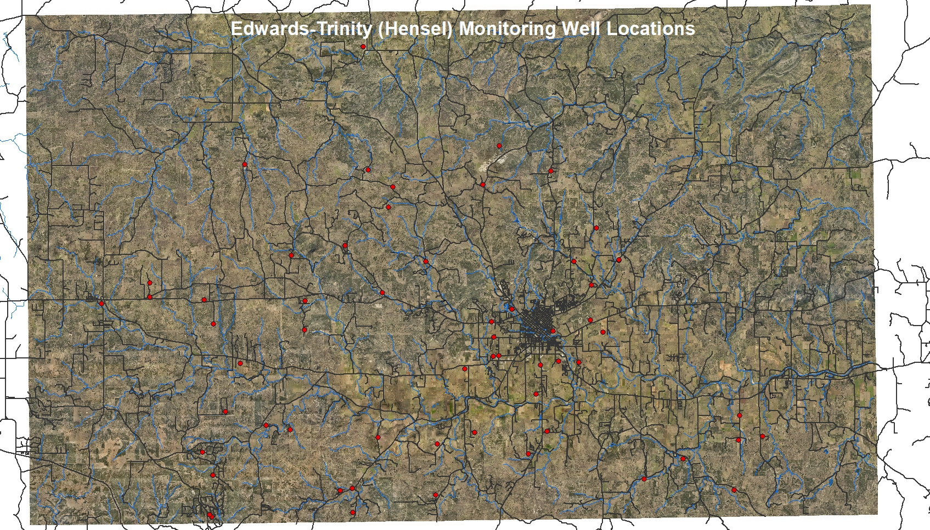

Slide 12
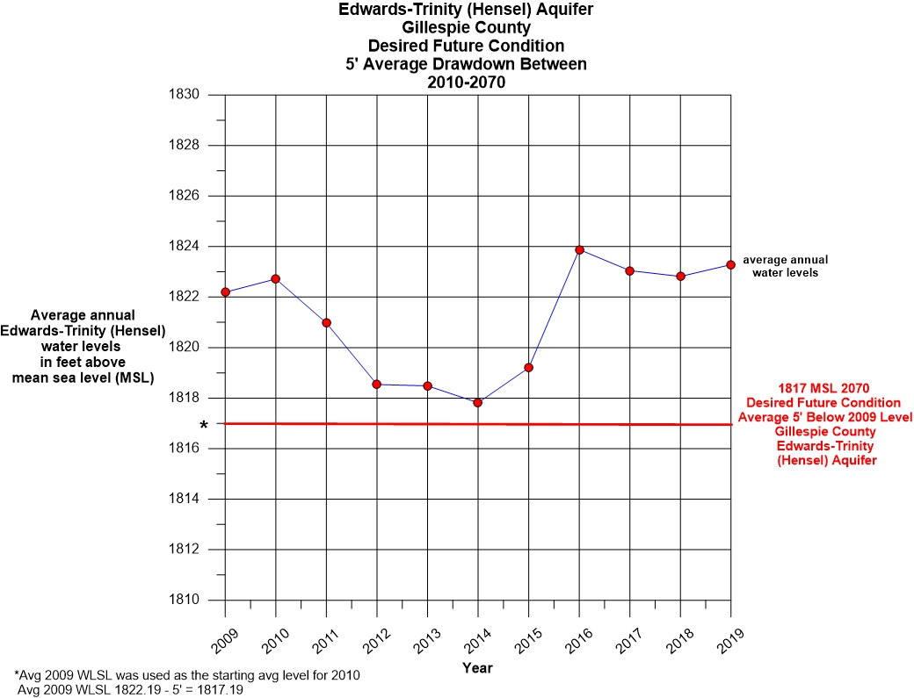

Slide 13
Hill Country Underground Water Conservation District
36.108 (c) 4: Achieving the DFC
DFC: average drawdown in the Ellenburger:
8 feet
Estimated Modeled Available Groundwater in the Edwards-Trinity (Hensel):
6,294 acre-feet
See next slide for map

Slide 14
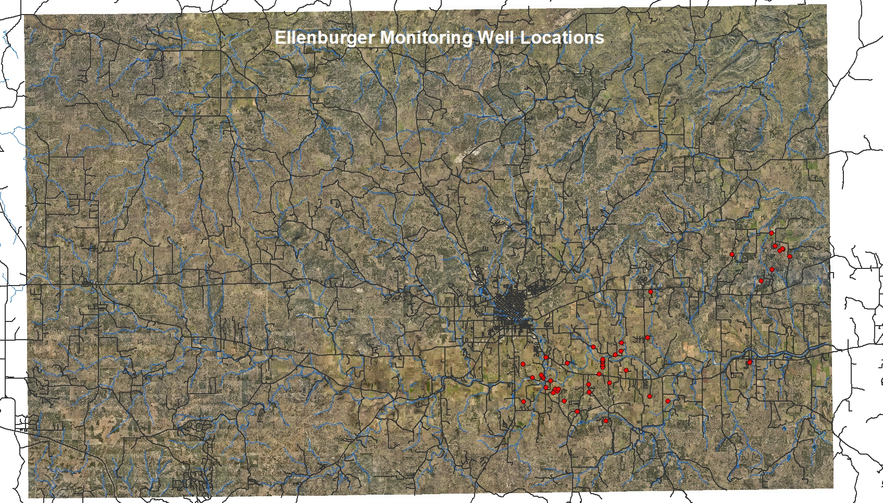

Slide 15
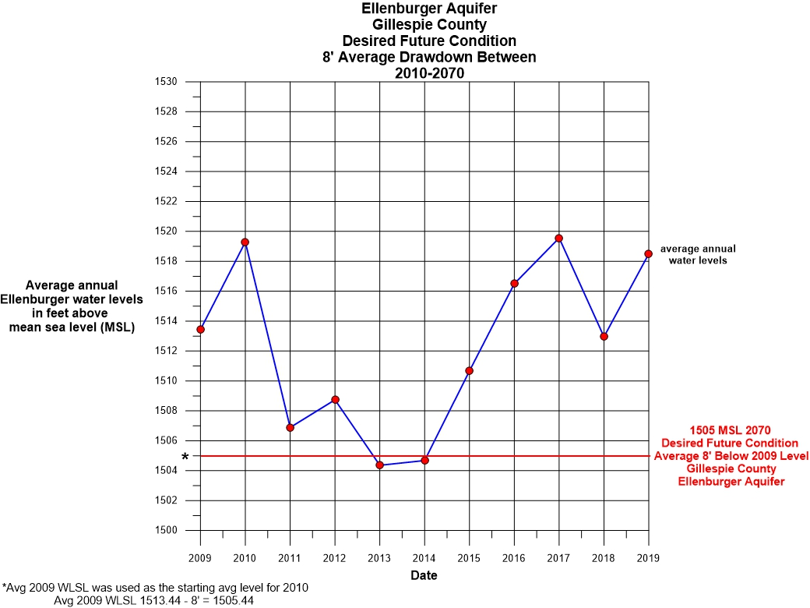

Slide 16
Hill Country Underground Water Conservation District
36.108 (c) 4: Achieving the DFC
DFC: average drawdown in the Hickory:
9 feet
Estimated Modeled Available Groundwater in the Edwards-Trinity (Hensel):
1,751 acre-feet
See next slide for map

Slide 17
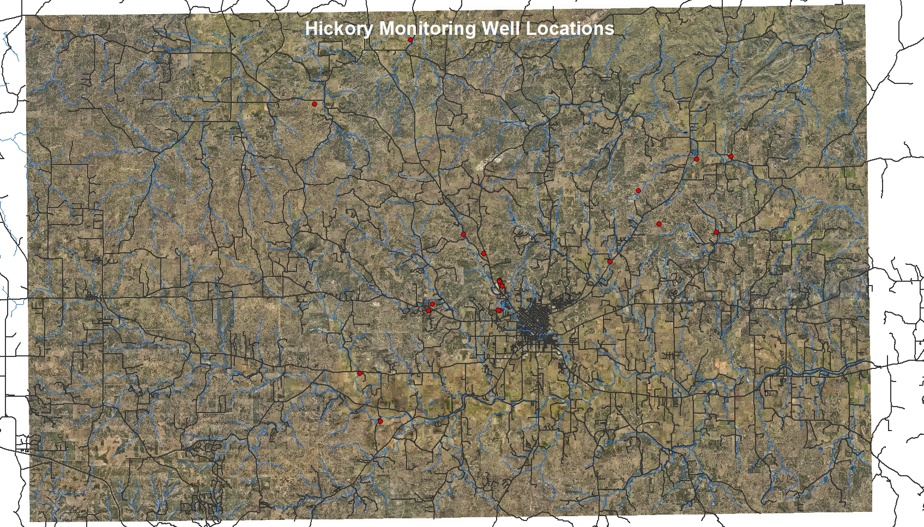

Slide 18
